Slide 1



Module 3 Quiz Review
DATA 3300
Business Data Analytics

Slide 2
Quiz Format
Unit Quiz is via Proctorio
Test alone in a quiet room – Tip: put phone on Do Not Disturb
40 multiple-choice questions in 60 minutes
No electronic devices, books, or other resources allowed
No hardcopy resources allowed except an 8.5”x11” note sheet

Slide 3
Study Recommendations
Attending today
Reviewing study guide
Preparing your note sheet
As necessary, reviewing course materials (PPTs/videos, exercises/demonstration videos, and final project)

Slide 4
Data Analyti-X
Divide into 8 teams
If your team answers correctly, steal three Xs from 1-3 other teams & add three Xs to your (only your) team’s score
If your team answers incorrectly, lose two Xs from your team’s score
If you run out of Xs, your team still plays to earn back Xs
Winning team earns extra credit; if more than one team wins, EC is cut in half
If you intentionally answer incorrectly, no EC is awarded
5 rounds of questions
30 seconds to answer (timer in lower right) – use knowledge & strategy!

Slide 5
Module 3 Quiz Review: Practice Questions

Slide 6
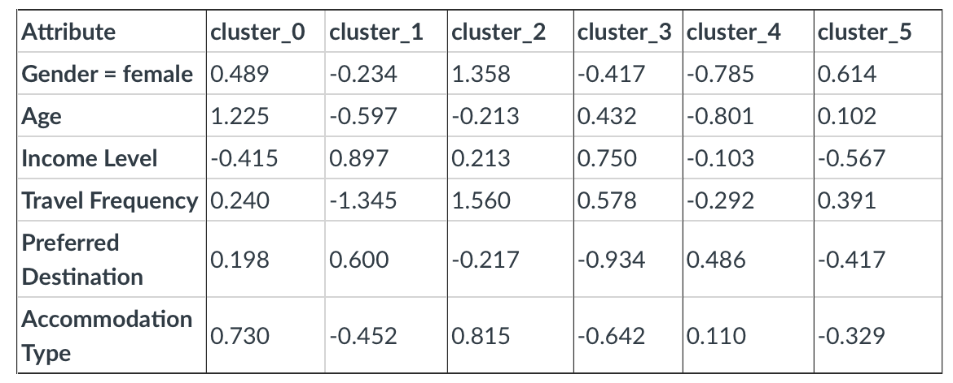
Q1: Identify the centroid value of the Travel Frequency variable for Cluster 2 using the table
1.358
-0.234
1.560
0.750

Slide 7
Q1: Identify the centroid value of the Travel Frequency variable for Cluster 2 using the table
1.358
-0.234
1.560
0.750

Slide 8
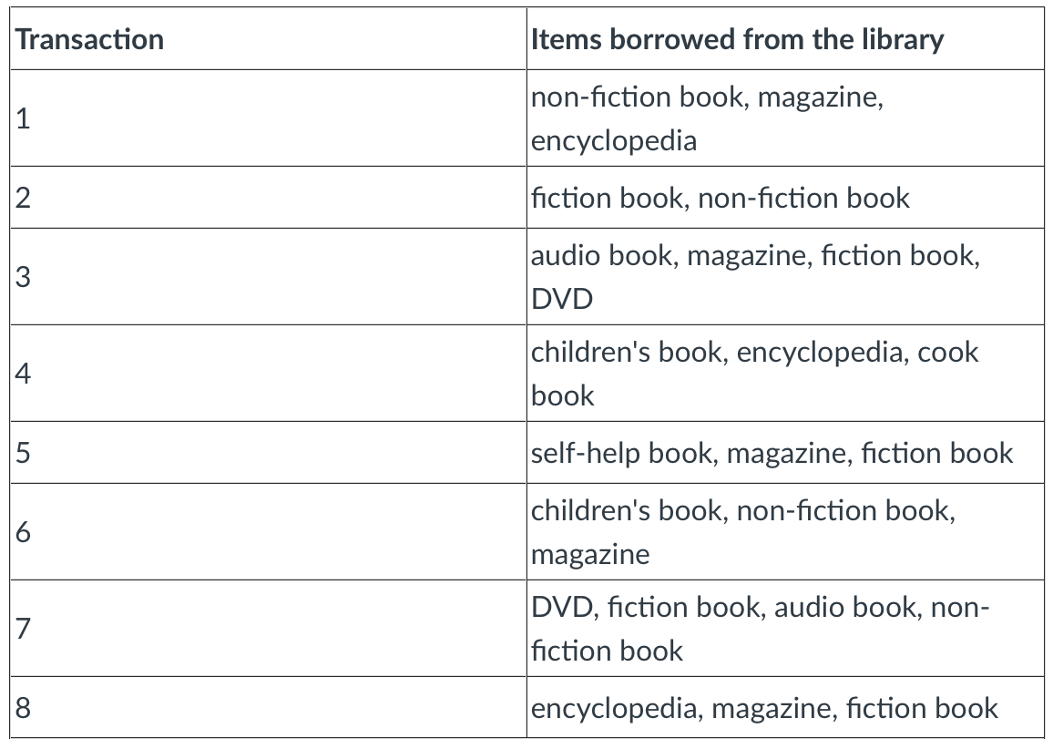
Q2: What is the support count of a non-fiction book in this dataset?
1
2
4
1/4

Slide 9





Q2: What is the support count of a non-fiction book in this dataset?
1
2
4
1/4

Slide 10
Q3: Which correlation coefficient represents the strongest negative relationship between two variables?
0.05
0.95
-0.14
-0.85

Slide 11
Q3: Which correlation coefficient represents the strongest negative relationship between two variables?
0.05
0.95
-0.14
-0.85

Slide 12
Q4: Which of the following is a use of correlation analysis?
Predict the outcome of one variable based on another
Evaluate the strength and direction of the relationship between two variables
Test the causal relationship between two variables
Find hidden groupings in data

Slide 13
Q4: Which of the following is a use of correlation analysis?
Predict the outcome of one variable based on another
Evaluate the strength and direction of the relationship between two variables
Test the causal relationship between two variables
Find hidden groupings in data

Slide 14
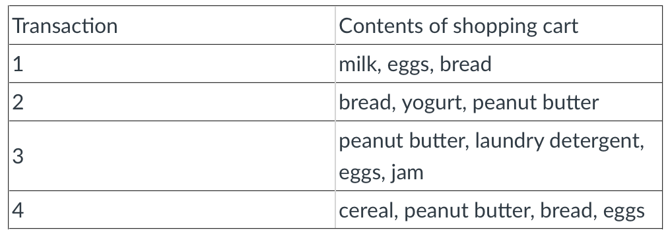
Q5: What is the support of the item set {bread, peanut butter}?
0.5
0.25
0.75
Cannot be determined

Slide 15





Q5: What is the support of the item set {bread, peanut butter}?
0.5
0.25
0.75
Cannot be determined

Slide 16
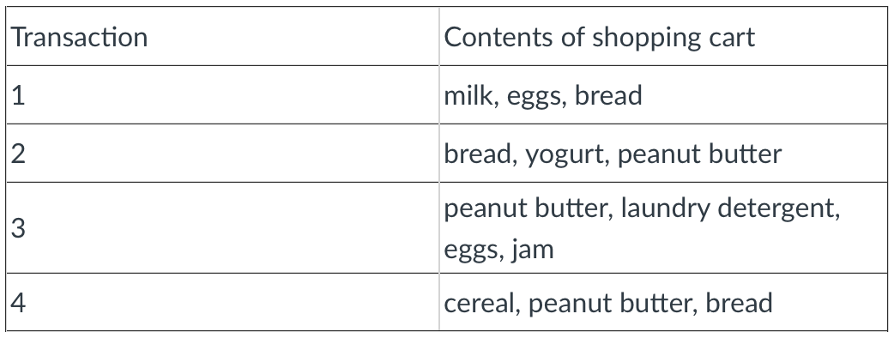
Q6: What is the confidence of the association rule {peanut butter} → {eggs}?
1/2
3
1/3
Cannot be determined

Slide 17
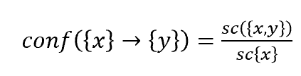



Q6: What is the confidence of the association rule {peanut butter} → {eggs}?
1/2
3
1/3
Cannot be determined

Slide 18
Q7: The standardized centroid value for Salary in Cluster 0 is 0.391. What does this suggest about the mean value of salary for this cluster before standardization?
It was above the standard deviation for the sample
It was above the mean value for the sample
It was equal to 0.391 of the mean
39.1% of salary values were clustered in this group

Slide 19
Q7: The standardized centroid value for Salary in Cluster 0 is 0.391. What does this suggest about the mean value of salary for this cluster before standardization?
It was above the standard deviation for the sample
It was above the mean value for the sample
It was equal to 0.391 of the mean
39.1% of salary values were clustered in this group

Slide 20
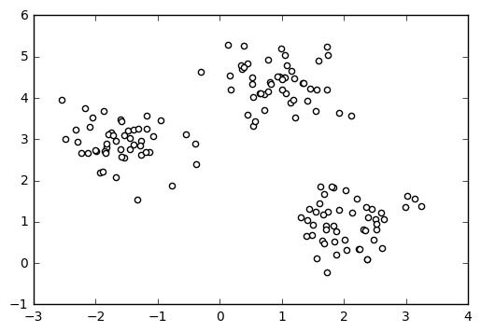
Q8: You have created a scatter plot showing Customer Ratings (0-100 scale) on the x-axis and Length of Customer Membership (in years) on the y-axis. Based on the visualization, there seem to be distinct groupings of customers. Based on this visualization, what can you conclude?
There are 3 clusters of customers.
The scatter plot shows 4 clusters of customers.
There appears to be some clustering, but further analysis is needed to confirm the number of clusters.
There are 2 clusters of customers.

Slide 21
Q8: You have created a scatter plot showing Customer Ratings (0-100 scale) on the x-axis and Length of Customer Membership (in years) on the y-axis. Based on the visualization, there seem to be distinct groupings of customers. Based on this visualization, what can you conclude?
There are 3 clusters of customers.
The scatter plot shows 4 clusters of customers.
There appears to be some clustering, but further analysis is needed to confirm the number of clusters.
There are 2 clusters of customers.

Slide 22
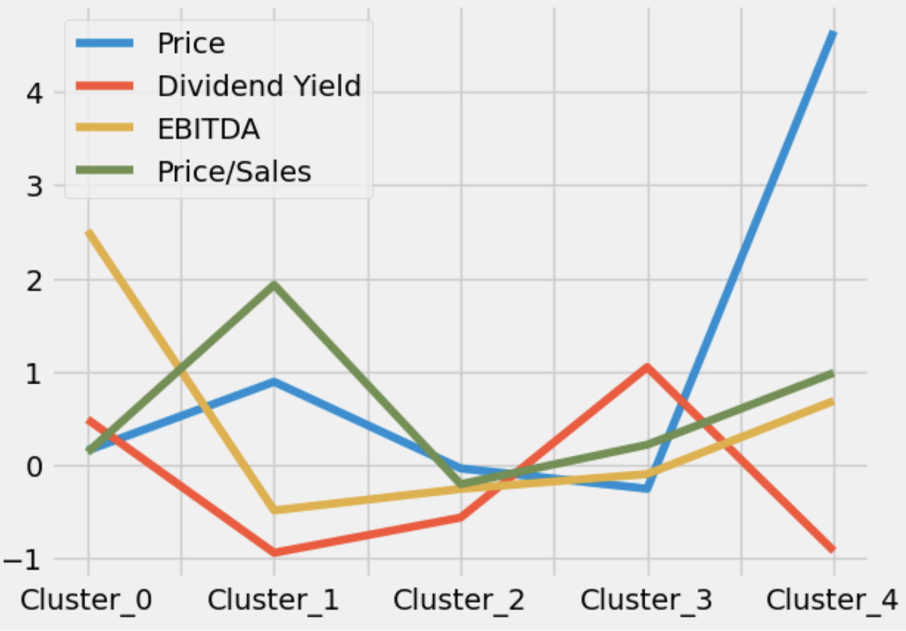
Q9: Based on this graph, which cluster has the highest Price/Sales?
Cluster 3
Cluster 2
Cluster 0
Cluster 1

Slide 23
Q9: Based on this plot, which cluster has the highest Price/Sales?
Cluster 3
Cluster 2
Cluster 0
Cluster 1

Slide 24
Q10: Given a centroid table, how would you identify a suitable name for a cluster based on its distinguishing attributes?
Analyze the attributes with the highest and lowest centroid values, as they indicate which characteristics are most prominent for that cluster.
Choose the attribute with the smallest centroid value as it shows the least variability and is most representative of the cluster.
Focus on the attributes closest to zero, since they represent the average behavior of all clusters.
Select the most common attribute across all clusters, as that attribute is likely to be representative of all clusters.

Slide 25
Q10: Given a centroid table, how would you identify a suitable name for a cluster based on its distinguishing attributes?
Analyze the attributes with the highest and lowest centroid values, as they indicate which characteristics are most prominent for that cluster.
Choose the attribute with the smallest centroid value as it shows the least variability and is most representative of the cluster.
Focus on the attributes closest to zero, since they represent the average behavior of all clusters.
Select the most common attribute across all clusters, as that attribute is likely to be representative of all clusters.

Slide 26
Q11: Which of the following is something to be aware of when using categorical variables in a clustering analysis?
Categorical variables never influence cluster results, so no adjustments are necessary.
Categorical variables need to be dummy coded (1s/0s).
Categorical variables severely distort cluster analysis.
Categorical variables should be removed because clustering algorithms only work with numerical data.

Slide 27
Q11: Which of the following is something to be aware of when using categorical variables in a clustering analysis?
Categorical variables never influence cluster results, so no adjustments are necessary.
Categorical variables need to be dummy coded (1s/0s).
Categorical variables severely distort cluster analysis.
Categorical variables should be removed because clustering algorithms only work with numerical data.

Slide 28
Q12: In an association analysis of shopping cart contents, you observe a lift value of 3 for {milk, eggs} --> {bread}. What is the appropriate interpretation of this value?
Customers who buy milk or eggs are three times more likely to also buy bread than if the purchases of bread were independent of milk or eggs.
Customers who buy milk and eggs are three times more likely to also buy bread compared to those who do not buy milk and eggs.
There is a negative correlation between milk, eggs, and bread purchases.
The purchase of bread will decrease if customers buy milk and eggs.

Slide 29
Q12: In an association analysis of shopping cart contents, you observe a lift value of 3 for {milk, eggs} --> {bread}. What is the appropriate interpretation of this value?
Customers who buy milk or eggs are three times more likely to also buy bread than if the purchases of bread were independent of milk or eggs.
Customers who buy milk and eggs are three times more likely to also buy bread compared to those who do not buy milk and eggs.
There is a negative correlation between milk, eggs, and bread purchases.
The purchase of bread will decrease if customers buy milk and eggs.

Slide 30
Q13: Which of the following are limitations of cluster analysis?
Cluster analysis provides a statistical framework for making inferences.
The results of cluster analysis are generalizable.
Cluster analysis may incorrectly identify outliers as a cluster with 1-2 objects in it.
Cluster analysis will generate clusters even if the underlying data does not reveal any meaningful grouping.

Slide 31
Q13: Which of the following are limitations of cluster analysis?
Cluster analysis provides a statistical framework for making inferences.
The results of cluster analysis are generalizable.
Cluster analysis may incorrectly identify outliers as a cluster with 1-2 objects in it.
Cluster analysis will generate clusters even if the underlying data does not reveal any meaningful grouping.

Slide 32
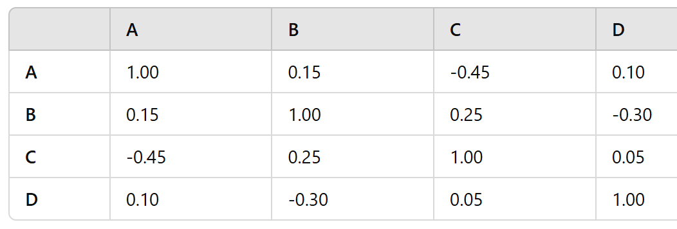
Q14: Which of the following is true?
There is a weak positive relationship between variables A and C.
As variable B increases, variable D tends to decrease.
Variables C and D have a strong positive relationship.
There is a moderate negative relationship between variables A and B.

Slide 33
Q14: Which of the following is true?
There is a weak positive relationship between variables A and C.
As variable B increases, variable D tends to decrease.
Variables C and D have a strong positive relationship.
There is a moderate negative relationship between variables A and B.

Slide 34
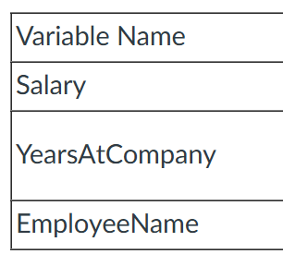
Q15: You are conducting a cluster analysis to segment employees based on their compensation and experience using the following dataset. Which variable would you exclude?
Exclude Salary because it does not significantly vary among employees.
Exclude YearsAtCompany because it is not directly related to employee performance.
Exclude EmployeeName because it is an identification attribute.
Include all variables because each provides relevant information for understanding employee segments.

Slide 35
Q15: You are conducting a cluster analysis to segment employees based on their compensation and experience using the following dataset. Which variable would you exclude?
Exclude Salary because it does not significantly vary among employees.
Exclude YearsAtCompany because it is not directly related to employee performance.
Exclude EmployeeName because it is an identification attribute.
Include all variables because each provides relevant information for understanding employee segments.

Slide 36
Q16: How to outliers typically impact cluster analysis?
They have no effect on the formation of cluster centroids.
They improve the accuracy of cluster assignments by increasing data diversity.
They can distort cluster centers which impacts interpretation of the clusters.
They only impact cluster analysis if the dataset is large.

Slide 37
Q16: How to outliers typically impact cluster analysis?
They have no effect on the formation of cluster centroids.
They improve the accuracy of cluster assignments by increasing data diversity.
They can distort cluster centers which impacts interpretation of the clusters.
They only impact cluster analysis if the dataset is large.

Slide 38
Q17: Which of the following is NOT a reason why cluster analysis is considered Unsupervised Data Mining?
Cluster analysis does not rely on predefined labels.
Cluster analysis aims to discover hidden patterns in the data without any prior knowledge of the categories.
Cluster analysis requires a training dataset with known classifications to validate the effectiveness of the clustering process.
All of the above

Slide 39
Q17: Which of the following is NOT a reason why cluster analysis is considered Unsupervised Data Mining?
Cluster analysis does not rely on predefined labels.
Cluster analysis aims to discover hidden patterns in the data without any prior knowledge of the categories.
Cluster analysis requires a training dataset with known classifications to validate the effectiveness of the clustering process.
All of the above

Slide 40
Q18: Which of the following statements is true regarding the use of quantitative and qualitative data in cluster analysis?
Cluster analysis can only be performed on quantitative data because clustering algorithms rely solely on numerical distance metrics.
Qualitative data cannot be used in clustering as it lacks numerical values and does not provide meaningful insights for group formation.
Both quantitative and qualitative data can be used in cluster analysis, but qualitative data often requires transformation into a suitable numerical format for effective clustering.
Cluster analysis exclusively focuses on qualitative data to identify patterns without any numerical analysis involved.

Slide 41
Q18: Which of the following statements is true regarding the use of quantitative and qualitative data in cluster analysis?
Cluster analysis can only be performed on quantitative data because clustering algorithms rely solely on numerical distance metrics.
Qualitative data cannot be used in clustering as it lacks numerical values and does not provide meaningful insights for group formation.
Both quantitative and qualitative data can be used in cluster analysis, but qualitative data often requires transformation into a suitable numerical format for effective clustering.
Cluster analysis exclusively focuses on qualitative data to identify patterns without any numerical analysis involved.

Slide 42
Q19: Before proceeding to the Modeling phase in the CRISP-DM framework, which of the following steps must be completed? Select all that apply.
Deployment
Business understanding
Data preparation
Model evaluation

Slide 43
Q19: Before proceeding to the Modeling phase in the CRISP-DM framework, which of the following steps must be completed? Select all that apply.
Deployment
Business understanding
Data preparation
Model evaluation

Slide 44
Q20: What happens to centroid values as new observations are added to their clusters?
Centroids remain the same
Centroids shift to the mean of all cluster members
Centroids move towards the farthest observation
Centroids are recalculated only at the end of the clustering progress

Slide 45
Q20: What happens to centroid values as new observations are added to their clusters?
Centroids remain the same
Centroids shift to the mean of all cluster members
Centroids move towards the farthest observation
Centroids are recalculated only at the end of the clustering progress

Slide 46
Q21: Which of the following is the correct sequence of steps in running and interpreting a cluster analysis?
Preprocess data → Define distance metric → Assign clusters → Evaluate results
Assign clusters → Evaluate results → Define distance metric → Preprocess data
Evaluate results → Preprocess data → Assign clusters → Define distance metric
Define distance metric → Preprocess data → Evaluate results → Assign clusters

Slide 47
Q21: Which of the following is the correct sequence of steps in running and interpreting a cluster analysis?
Preprocess data → Define distance metric → Assign clusters → Evaluate results
Assign clusters → Evaluate results → Define distance metric → Preprocess data
Evaluate results → Preprocess data → Assign clusters → Define distance metric
Define distance metric → Preprocess data → Evaluate results → Assign clusters

Slide 48
Q22: What are some common approaches analysts use to determine the most appropriate value of k in clustering? Select all that apply.
Elbow Rule
Tractability
Model Overfitting
Post-Hoc Evaluation

Slide 49
Q22: What are some common approaches analysts use to determine the most appropriate value of k in clustering? Select all that apply.
Elbow Rule
Tractability
Model Overfitting
Post-Hoc Evaluation

Slide 50
Q23: Why is standardization necessary for cluster analysis?
It increases the number of clusters formed.
It ensures all features contribute equally to the distance calculation.
It removes outliers from the dataset.
It speeds up the clustering algorithm.

Slide 51
Q23: Why is standardization necessary for cluster analysis?
It increases the number of clusters formed.
It ensures all features contribute equally to the distance calculation.
It removes outliers from the dataset.
It speeds up the clustering algorithm.

Slide 52
Q24: When running an association analysis, data are required to be in binominal form
True
False

Slide 53
Q24: When running an association analysis, data are required to be in binominal form
True
False

Slide 54
Q25: What does market basket analysis typically identify?
The time customers spend shopping
Which customers are likely to leave a service
The average revenue per basket
How products are grouped in customer baskets

Slide 55
Q25: What does market basket analysis typically identify?
The time customers spend shopping
Which customers are likely to leave a service
The average revenue per basket
How products are grouped in customer baskets

Slide 56
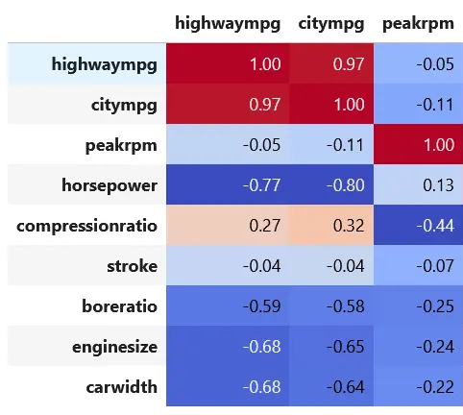
Q26: Given the correlation matrix below, which of the following statements best describes the potential for multicollinearity among the variables?
All variables are independent of each other
peakrpm has no correlation with any other variable
There is a high risk of multicollinearity between citympg and highwaympg
Variables highwaympg, citympg, and peakrpm are all strongly correlated, indicating multicollinearity

Slide 57
Q26: Given the correlation matrix below, which of the following statements best describes the potential for multicollinearity among the variables?
All variables are independent of each other
peakrpm has no correlation with any other variable
There is a high risk of multicollinearity between citympg and highwaympg
Variables highwaympg, citympg, and peakrpm are all strongly correlated, indicating multicollinearity

Slide 58
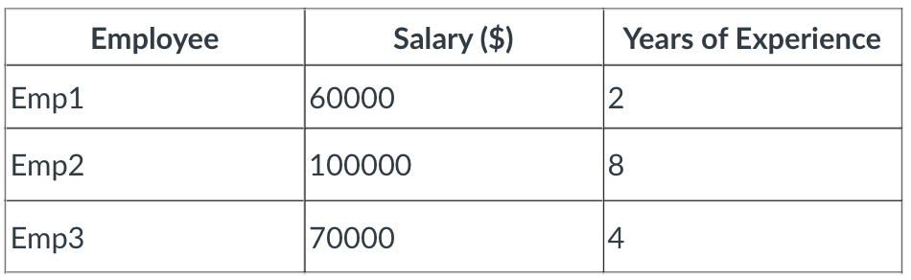
Q27: Given the data below for cluster analysis, which statement is the most accurate?
Emp1 is likely to be in a distinct cluster due to its low salary.
Emp1 and Emp2 are the least likely to be grouped together.
Emp1 and Emp3 would be least likely to be grouped together.
Emp2 and Emp3 would be grouped together because of their similar years of experience.

Slide 59
Q27: Given the data below for cluster analysis, which statement is the most accurate?
Emp1 is likely to be in a distinct cluster due to its low salary.
Emp1 and Emp2 are the least likely to be grouped together.
Emp1 and Emp3 would be least likely to be grouped together.
Emp2 and Emp3 would be grouped together because of their similar years of experience.

Slide 60
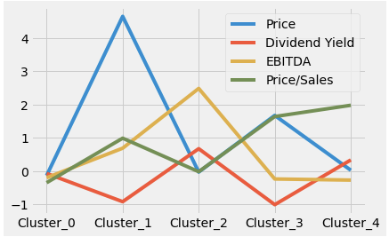
Q28: Using the plot below, which of the following is true?
The x-axis indicates the size of each cluster.
The y-axis shows the total sum of values for each variable in the cluster.
Each line in the plot corresponds to a different variable’s centroid value across clusters.
The lines represent the number of clusters in the analysis.

Slide 61
Q28: Using the plot below, which of the following is true?
The x-axis indicates the size of each cluster.
The y-axis shows the total sum of values for each variable in the cluster.
Each line in the plot corresponds to a different variable’s centroid value across clusters.
The lines represent the number of clusters in the analysis.

Slide 62
Q29: Which of the following statements best describes intraclass homogeneity in the context of cluster analysis?
Data points within each cluster are very dissimilar
Data points within each cluster are very similar
Clusters are very distinct from each other
Clusters are not distinct from each other

Slide 63
Q29: Which of the following statements best describes intraclass homogeneity in the context of cluster analysis?
Data points within each cluster are very dissimilar
Data points within each cluster are very similar
Clusters are very distinct from each other
Clusters are not distinct from each other

Slide 64
Q30: In cluster analysis, k is the ___, and its value is ___.
Euclidean distance; determined by the analyst
Number of clusters; determined by the algorithm
Euclidean distance; determined by the algorithm
Number of clusters; determined by the analyst

Slide 65
Q30: In cluster analysis, k is the ___, and its value is ___.
Euclidean distance; determined by the analyst
Number of clusters; determined by the algorithm
Euclidean distance; determined by the algorithm
Number of clusters; determined by the analyst

Slide 66
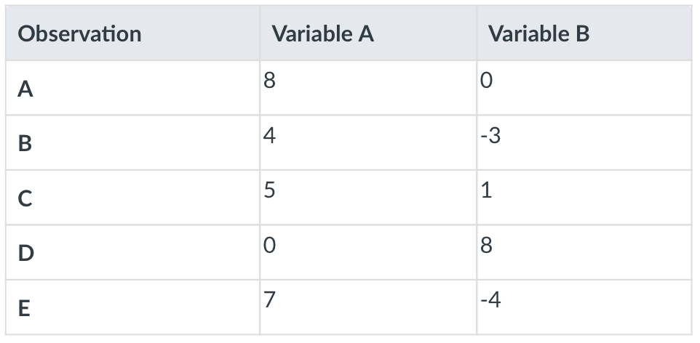
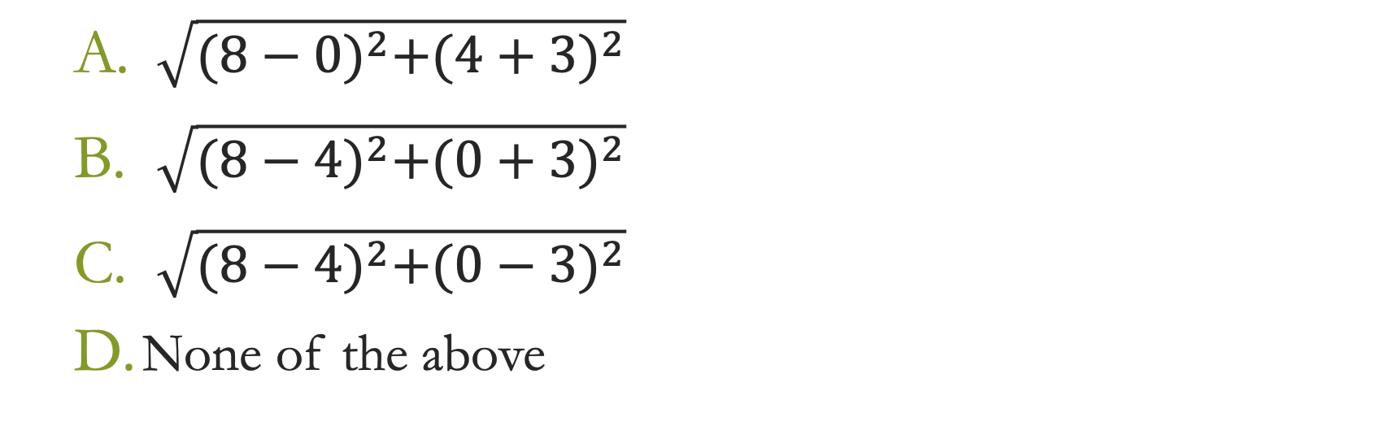
Q31: What is the Euclidean distance between observations A and B?
$\sqrt{{(8−0)}^{2}+{(4+3)}^{2}}$
$\sqrt{{(8−4)}^{2}+{(0+3)}^{2}}$
$\sqrt{{(8−4)}^{2}+{(0−3)}^{2}}$
None of the above

Slide 67
Q31: What is the Euclidean distance between observations A and B?
$\sqrt{{(8−0)}^{2}+{(4+3)}^{2}}$
$\sqrt{{(8−4)}^{2}+{(0+3)}^{2}}$
$\sqrt{{(8−4)}^{2}+{(0−3)}^{2}}$
None of the above

Slide 68
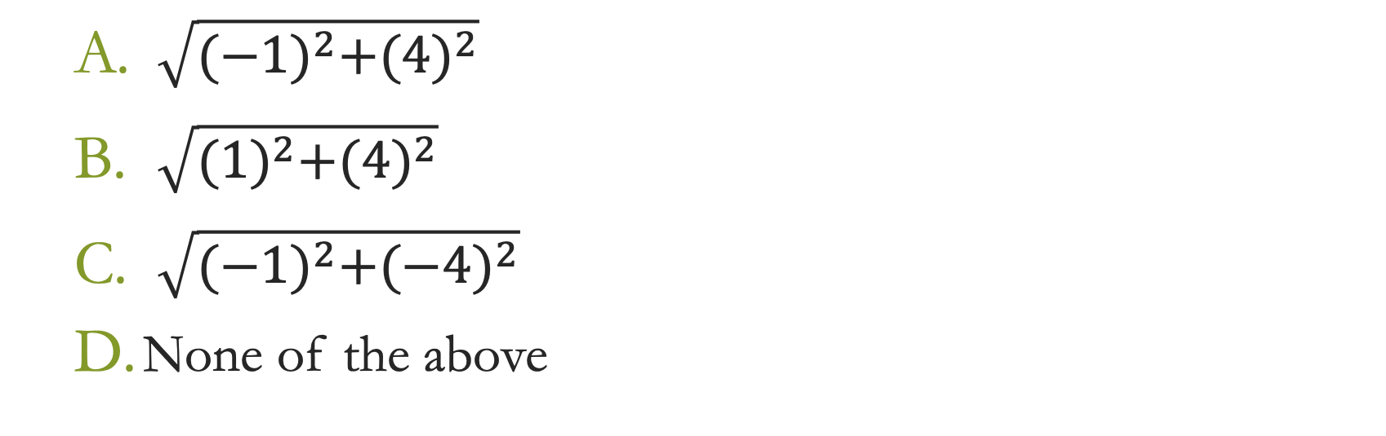
Q32: What is the Euclidean distance between objects B and C?
$\sqrt{{(−1)}^{2}+{(4)}^{2}}$
$\sqrt{{(1)}^{2}+{(4)}^{2}}$
$\sqrt{{(−1)}^{2}+{(−4)}^{2}}$
None of the above

Slide 69
Q32: What is the Euclidean distance between objects B and C?
$\sqrt{{(−1)}^{2}+{(4)}^{2}}$
$\sqrt{{(1)}^{2}+{(4)}^{2}}$
$\sqrt{{(−1)}^{2}+{(−4)}^{2}}$
None of the above

Slide 70
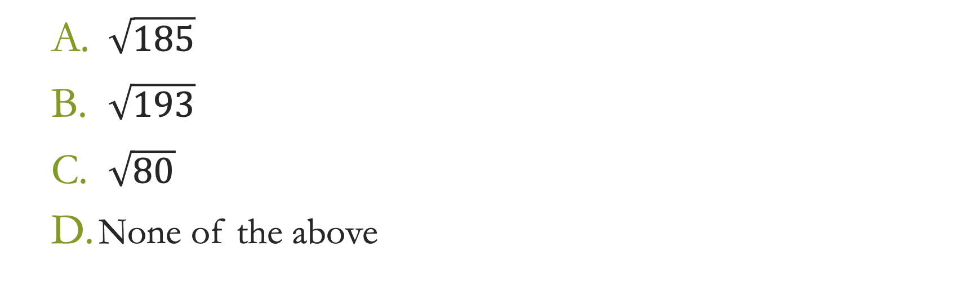
Q33: What is the Euclidean distance between objects D and E?
$\sqrt{185}$
$\sqrt{193}$
$\sqrt{80}$
None of the above

Slide 71
Q33: What is the Euclidean distance between objects D and E?
$\sqrt{185}$
$\sqrt{193}$
$\sqrt{80}$
None of the above

Slide 72
Q34: Mining data to uncover naturally existing patterns without trying to make predictions is called _____ mining.
Unsupervised
Supervised
Classification
Regression

Slide 73
Q34: Mining data to uncover naturally existing patterns without trying to make predictions is called _____ mining.
Unsupervised
Supervised
Classification
Regression

Slide 74
Q35: In the association rule {Flour, Eggs} → {Sugar} the antecedent is:
Flour
Eggs
Flour, eggs
None of the above

Slide 75
Q35: In the association rule {Flour, Eggs} → {Sugar} the antecedent is:
Flour
Eggs
Flour, eggs
None of the above

Slide 76
Q36: For the association rule {religious → hobbies}, confidence is 0.796. This means…
This rule occurs 79.6% of the time in this data set.
For club members who are religious, 79.6% of the time we’ll also see an association with hobbies.
For club members who are religious, we are 0.796 times more confident than the baseline probability that the club member also has hobbies.

Slide 77
Q36: For the association rule {religious → hobbies}, confidence is 0.796. This means…
This rule occurs 79.6% of the time in this data set.
For club members who are religious, 79.6% of the time we’ll also see an association with hobbies.
For club members who are religious, we are 0.796 times more confident than the baseline probability that the club member also has hobbies.

Slide 78
Q37: Lift can range from ____.
0 to 1
0 to positive infinity
-1 to 1
-1 to positive infinity

Slide 79
Q37: Lift can range from ____.
0 to 1
0 to positive infinity
-1 to 1
-1 to positive infinity

Slide 80
Q38: To measure similarity among multiple variables, a(n) ____ is needed.
Target variable
Centroid value
k variable
Aggregate distance measure

Slide 81
Q38: To measure similarity among multiple variables, a(n) ____ is needed.
Target variable
Centroid value
k variable
Aggregate distance measure

Slide 82
Q39: Cluster analysis answers this type of business question: Do ____ tend to cluster into natural groups?
Attributes
Observations
Centroids
k values

Slide 83
Q39: Cluster analysis answers this type of business question: Do ____ tend to cluster into natural groups?
Attributes
Observations
Centroids
k values

Slide 84
Q40: In cluster analysis, the objective is to ____ the distance between each observation and its centroid and ____ the distance between centroids.
Maximize; minimize
Minimize; maximize
Maximize; maximize
Minimize; minimize

Slide 85
Q40: In cluster analysis, the objective is to ____ the distance between each observation and its centroid and ____ the distance between centroids.
Maximize; minimize
Minimize; maximize
Maximize; maximize
Minimize; minimize

Slide 86
Bonus Question!
Each team can bet up to the number of points it currently has.
If the team correctly answers all portions of the following question, their score will increase by the number of points they bet.
If they incorrectly answer any of the following question, their score will decrease by the number of points they bet.
On a piece of paper, write team #, team names, # points you bet, and the answers to the following question…

Slide 87
Calculate the following for the rule {Toy Story} ➔ {Toy Story 2}
sc
supp
conf
lift
See association rules analysis PPT for equations.
Subscriber ID | Movies Watched
1 | Wish, Little Mermaid, Toy Story
2 | Toy Story, Toy Story 2, Moana
3 | Little Mermaid, Toy Story, Toy Story 2
4 | Moana, Cinderella, Strange World

Slide 88
Answers {Toy Story} ➔ {Toy Story 2}
sc = 2
supp = 2/4
conf = 2/3
lift = (2/3)/(2/4)
See association rules analysis PPT for equations.
Subscriber ID | Movies Watched
1 | Finding Nemo, Little Mermaid, Toy Story
2 | Toy Story, Toy Story 2, Moana
3 | Little Mermaid, Toy Story, Toy Story 2
4 | Moana, Cinderella, Little Mermaid

